Slide 1


TEAM:- DATA DETECTIVES
INNOMATICS
RESEARCH LABS

Slide 2


TABLE OF CONTENTS
Overview
Problem Statement
Timeline
Recommendation System
Literature Survey
Future Plans
Result Analysis
Technologies
References

Slide 3
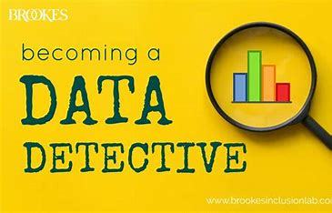
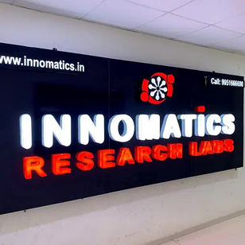
KEY PEOPLE
Trainer
Team
Mr. Kanav bansal
Data Detectives
Institution
Mentor
Innomatics Research labs
Mrs. Ramya Bhargavi

Slide 4
OVERVIEW
Our Philosophy
The rapid growth of digital media platforms and the availability of vast movie libraries have made it increasingly challenging for users to discover and choose movies that align with their preferences. To address this issue, movie recommendation systems have emerged as a powerful tool to enhance user experience and engagement in the entertainment industry
Our Mission
Our Goals
Enhance user satisfaction through personalized movie recommendations.
Personalize the movie-watching experience based on user preferences.
To Make different types of recommendation techniques like:-
1. Popularity based recommender system
2. Content based Recommender System
3. Collaborative Recommender System

Slide 5


PROBLEM STATEMENT
Using different techniques of Machine Learning, we need to build a Recommender System that recommends movies based on “ Cast, Genre, Reviews, TMDB/IMDB ratings”
Using different types of recommendation techniques like:
1. Popularity based Recommender System
2. Content based Recommender System
3. Collaborative Recommender System

Slide 6

TIMELINE
EDA
Model Building
Exploratory data Analysis using Univariate, Bivariate, Multivariate Graphs
Implemented of Machine Learning Algorithms KNN and NLP Techniques like TF-IDF for Building a accurate model.
Data Cleaning
Data Visualization
Model Deployment
Preparing a clean and reliable dataset for a movie recommendation
Multiple Data Visualization Tools which includes matplotlib, seaborn
Deployment of the Model on the User's Site using Streamlit Framework.

Slide 7


SYSTEMS
Collaborative-Based Recommender
Based on the technique that recommends movies based on the preferences and behaviors of similar users.
MOVIE RECOMMENDATION SYSTEM
Popularity-Based Recommender
Content-Based Recommender
Based on the Popularity Of the Movie in Specific Time Period.
Based on the TMDB/IMDB ratings of the Movie.

Slide 8

LITERATURE SURVEY
Paper 1
Paper 2
Title:-
Title:-
Content-Based Movie Recommendation System Using Genre Correlation
Toward the next generation of recommender systems: A survey of the state-of-the-art and possible extensions.
This survey paper provides a comprehensive overview of different recommendation techniques, including collaborative filtering, content-based filtering, along with their strengths and limitations.
In this paper, the recommendation system has been built on the type of genres that the user might prefer to watch. The approach adopted to do so is content-based filtering using genre correlation.

Slide 9

FUTURE PLANS
Hybrid recommendation systems that combine multiple techniques, such as collaborative, content-based, and popularity, can be developed to improve recommendation accuracy.
Incorporating contextual information, such as time, location, weather, and user mood, can enhance the relevance of movie recommendations.

Slide 10
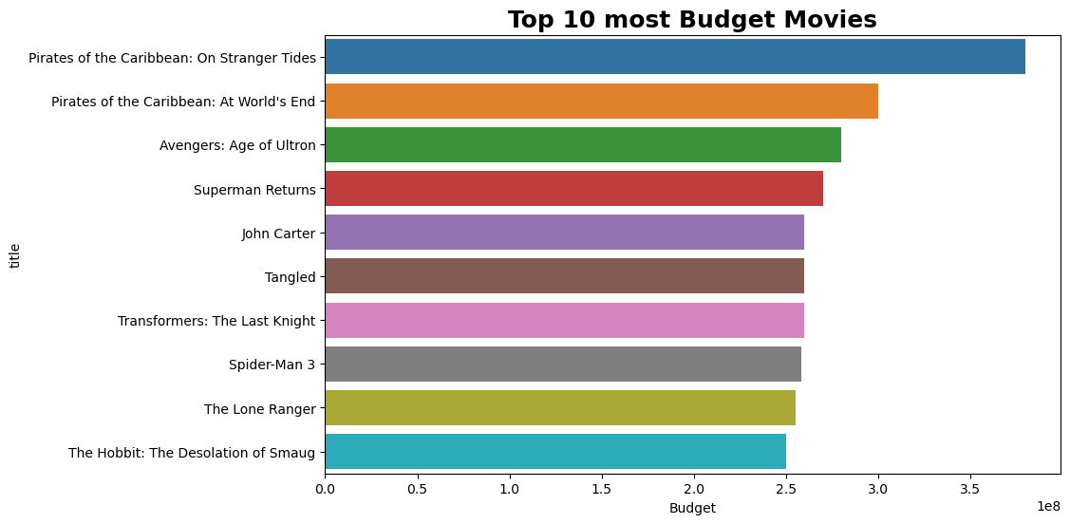

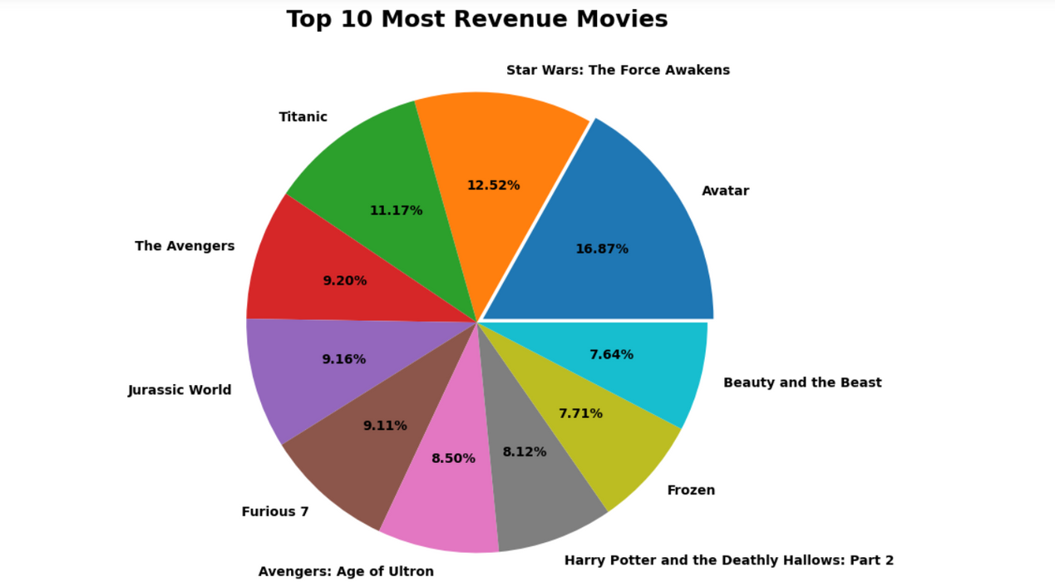
EXPLORATORY DATA ANALYSIS

Slide 11



RESULT ANALYSIS
Results of the Models we created:-

Slide 12
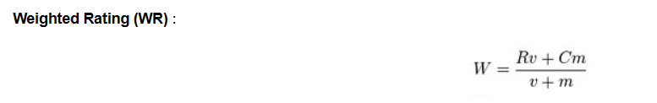
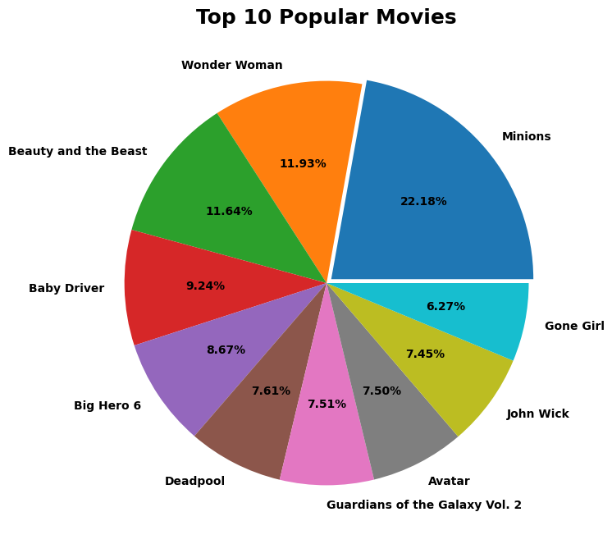
POPULARITY FILTERING
The Below Work shows the Working of the Popularity based Recommendation.
We have used Weight Rating Metric to sort the scores of every movies and select the top movies to be recommended.

Slide 13
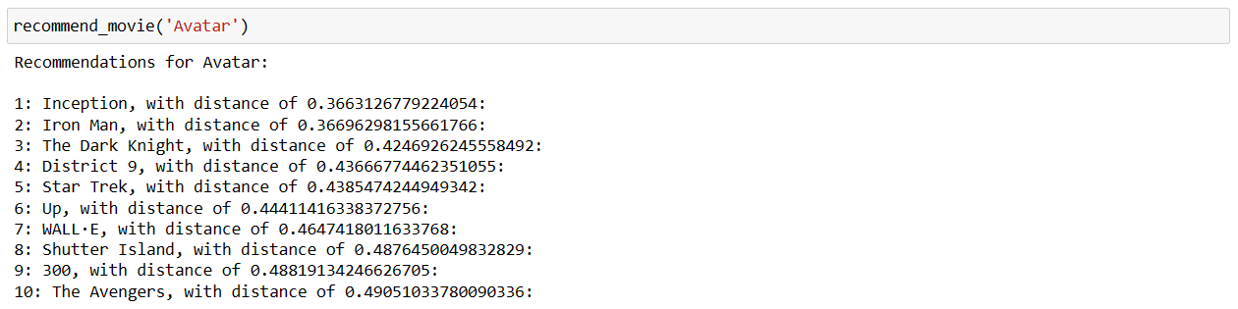
COLLABRATIVE FILTERING
In collaborative filtering the rating column is the most important attribute of the Data.
Implemented using KNN model and cosine similarity metric.
The model is trained on the movie features data, allowing it to find the nearest neighbors efficiently based on cosine similarity.
The below code depicts the working of the collaborative filtering model of the movie 'Avatar'.

Slide 14
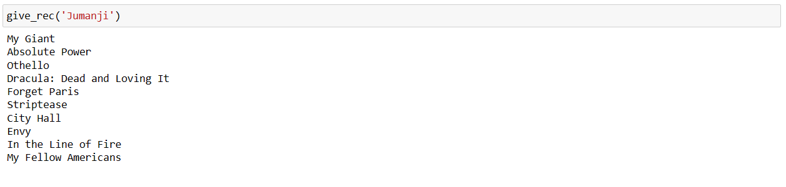
CONTENT FILTERING
In content filtering TF-IDF vectorizer is used to convert the text into the meaningful representation of numbers that fits into the machine learning algorithm.
TIt makes use of the attributes like cast, crew, spoken languages, genres and keywords .
The below code depicts the working of the content-based filtering model of the movie 'jumanji'.

Slide 15
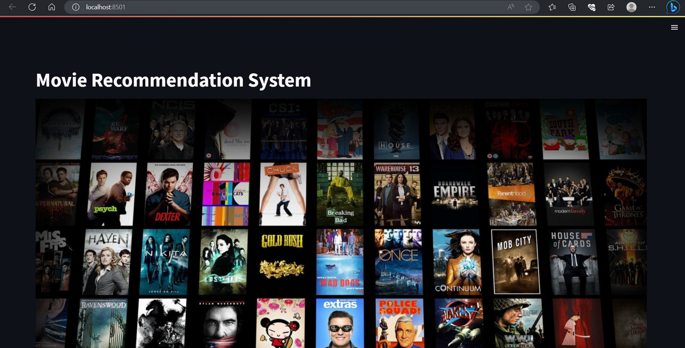
STREAMLIT WEB APP HOMEPAGE

Slide 16
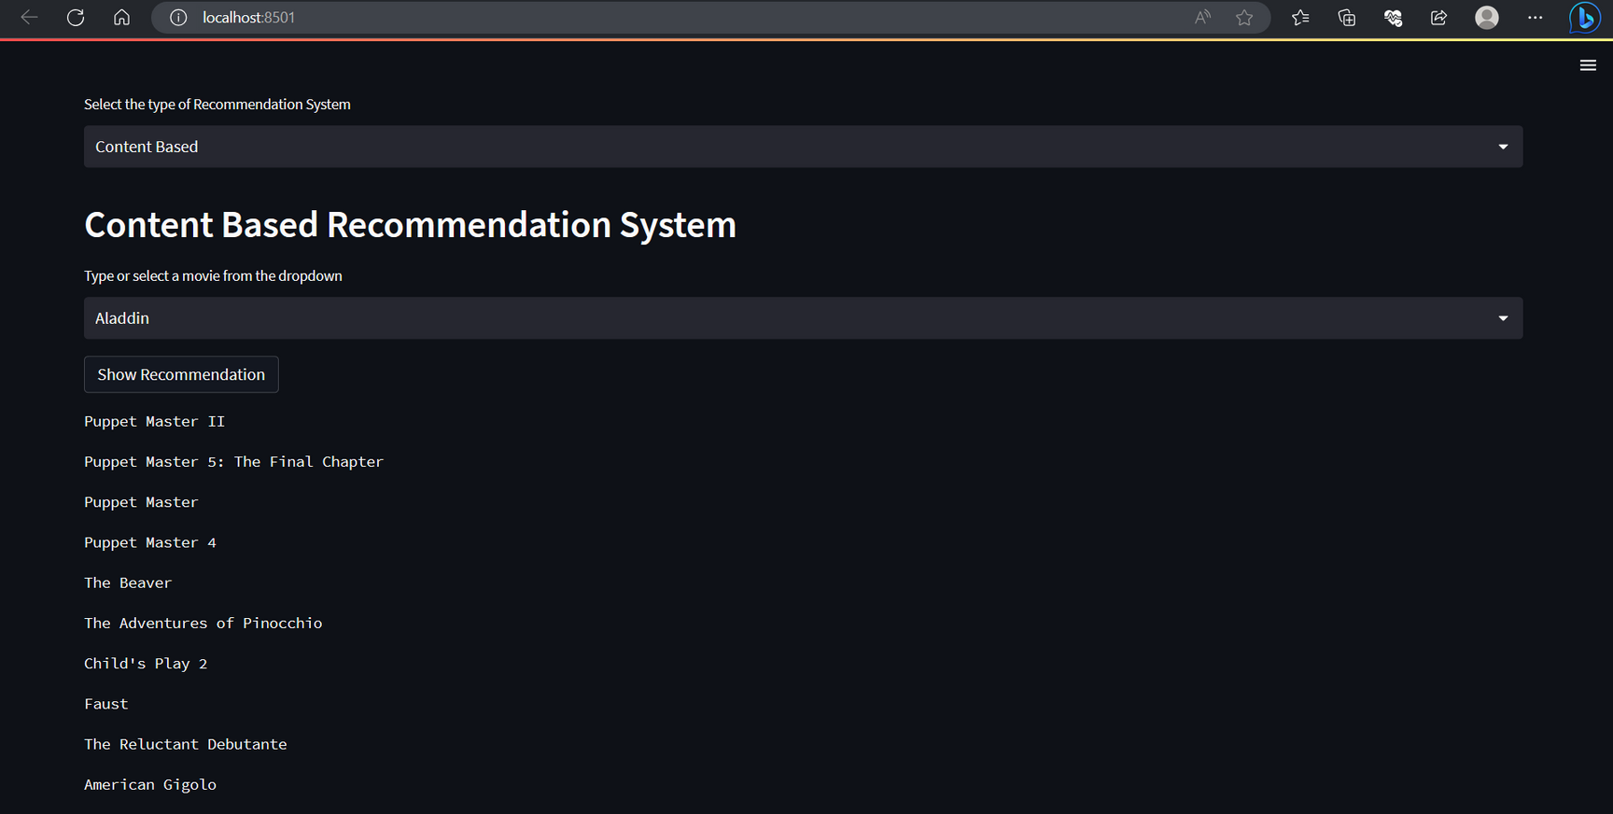
CONTENT BASED SYSTEM

Slide 17
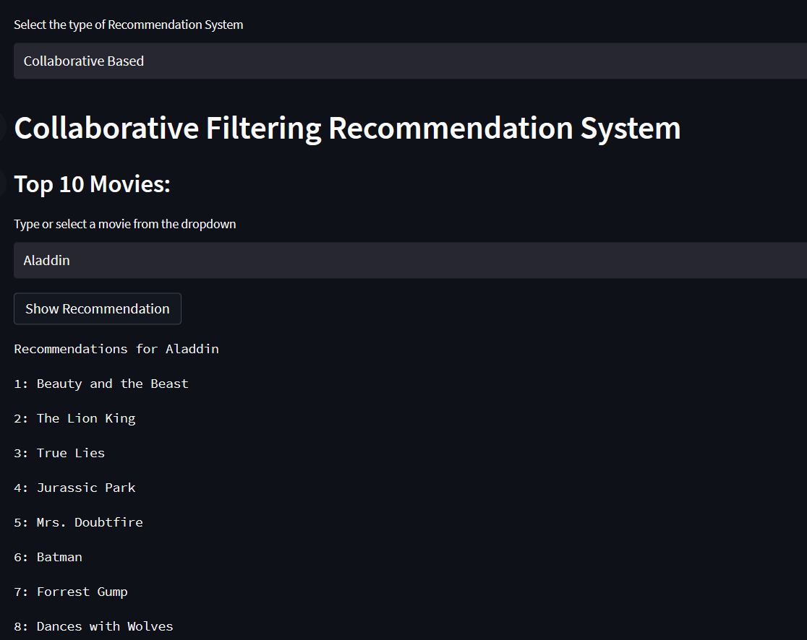
COLLABORATIVE SYSTEM

Slide 18
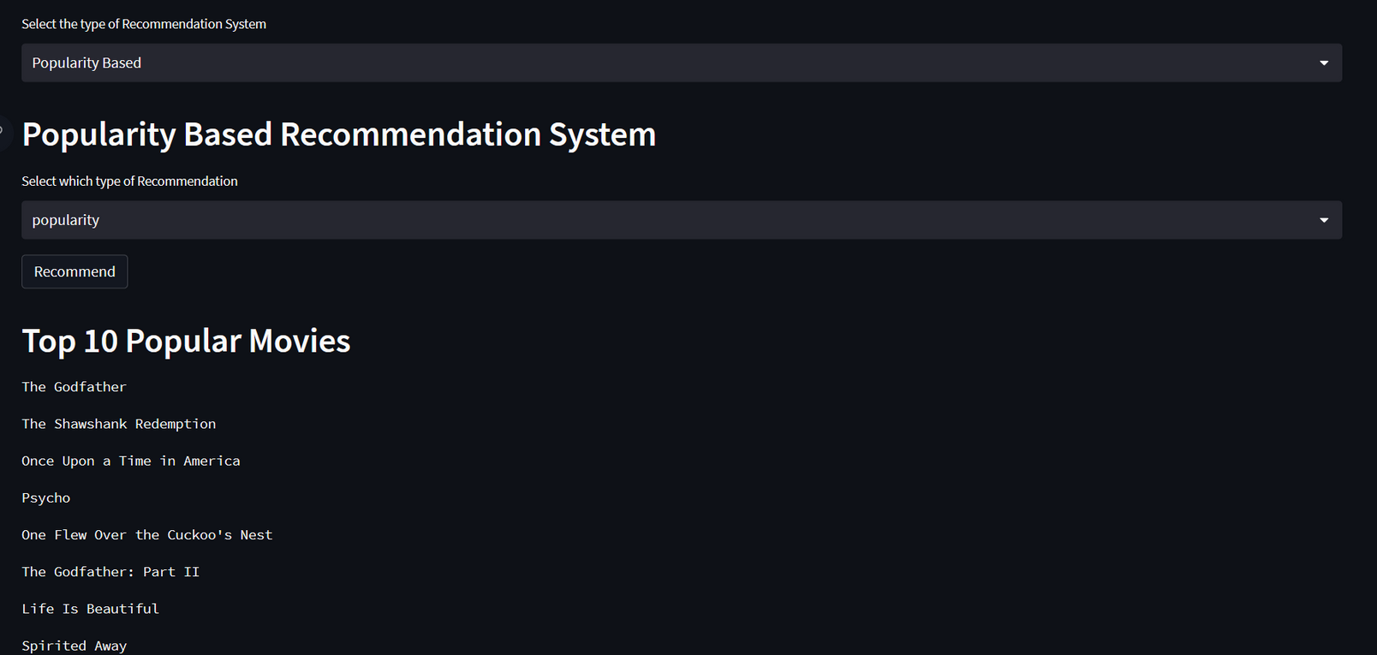
POPULARITY BASED SYSTEM

Slide 19

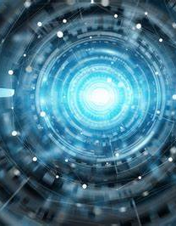




TECHNOLOGIES
The data of your company :
Languages used:-
Python
Algorithms:-
KNN(K-Nearest Neighbours)
NLP concepts like TF -IDF
Framework:-
Streamlit
Natural language Processing

Slide 20
REFERENCES
https://link.springer.com/chapter/10.1007/978-981-13-1927-3_42
https://www.kaggle.com/code/rounakbanik/movie-recommender-systems/input
https://medium.com/@cmukesh8688/tf-idf-vectorizer-scikit-learn-dbc0244a911a
https://www.scribd.com/document/606521254/Movie-recommendation-project-report#

Slide 21

THANK YOU

